Slide 1
Hackathon’25 : Solve Rubik’s Cube
By Garlapati Hema | KL University
Email: 2200031072cseh@gmail.com | ID: 2200031072

Slide 2
PROBLEM STATEMENT
-Solve any given 3x3 Rubik’s Cube scramble by mimicking real-world logic. -The solution must be valid, efficient, and visual. -We aim to simulate a realistic solver with optimization.

Slide 3
SOLUTION OVERVIEW
-Represent cube as dictionary of 3x3 faces - Moves handled via face and edge manipulation - Search Algorithm: IDA* (Iterative Deepening A*) - Output: Visual display + solution steps - Tracks solving time & scramble steps

Slide 4
ARCHITECTURE DESIGN
-Cube Class: Stores state, handles rotation logic -Solver Class (IDA*): Efficient search strategy -Visualizer: Matplotlib output of cube faces -Timer: Measures performance time

Slide 5
KEY FEATURES
-IDA* algorithm – depth-aware, fast solving -Input scrambles like: F R U R' U' F’ - Step-by-step animation using Matplotlib -Execution time shown (e.g. ~0.03 sec) - Colab compatible & beginner-friendly

Slide 6
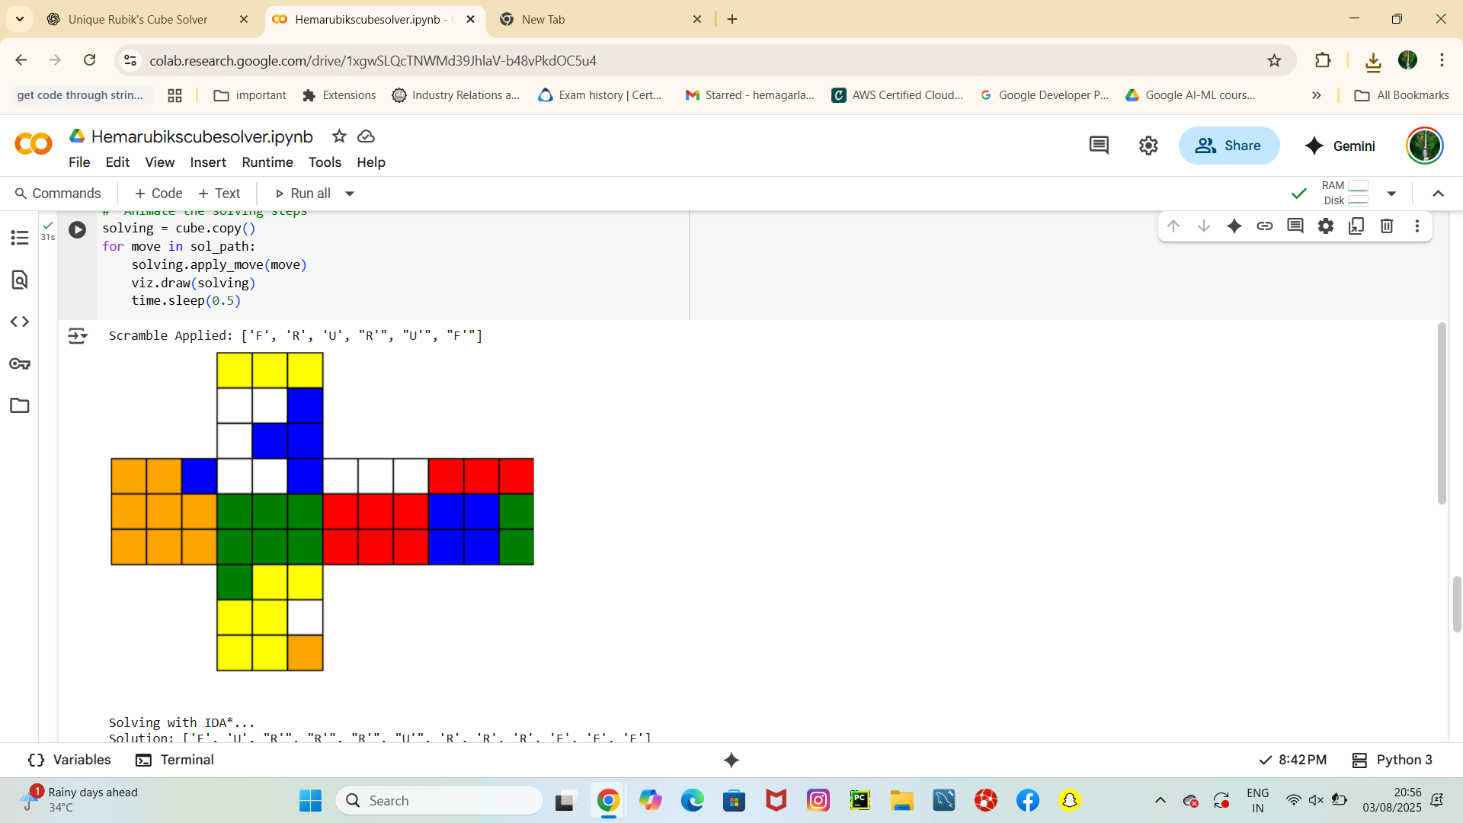
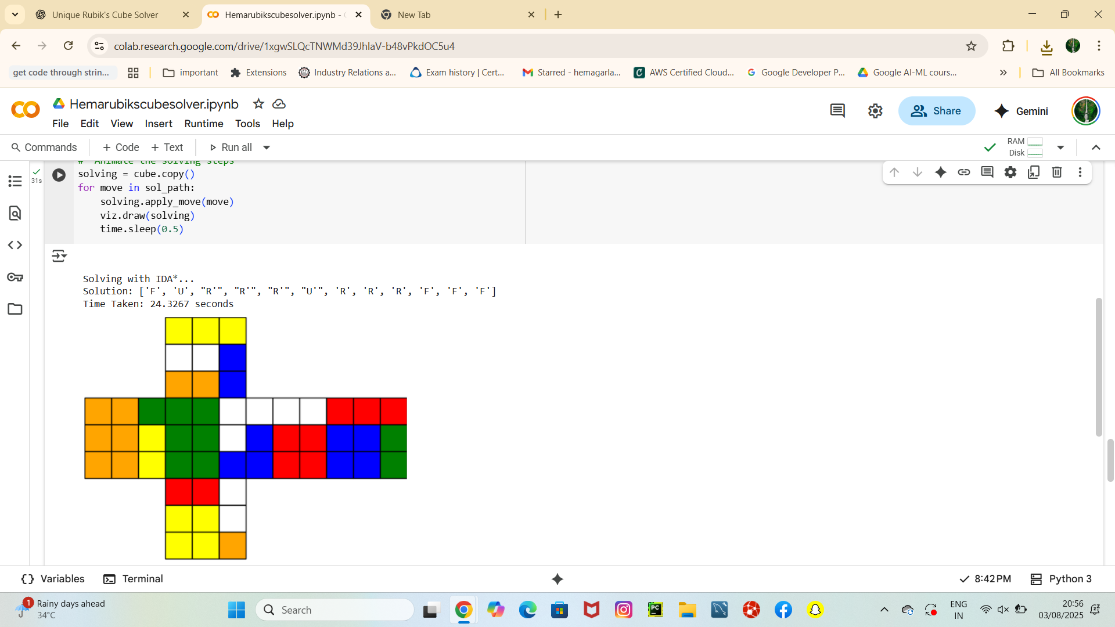
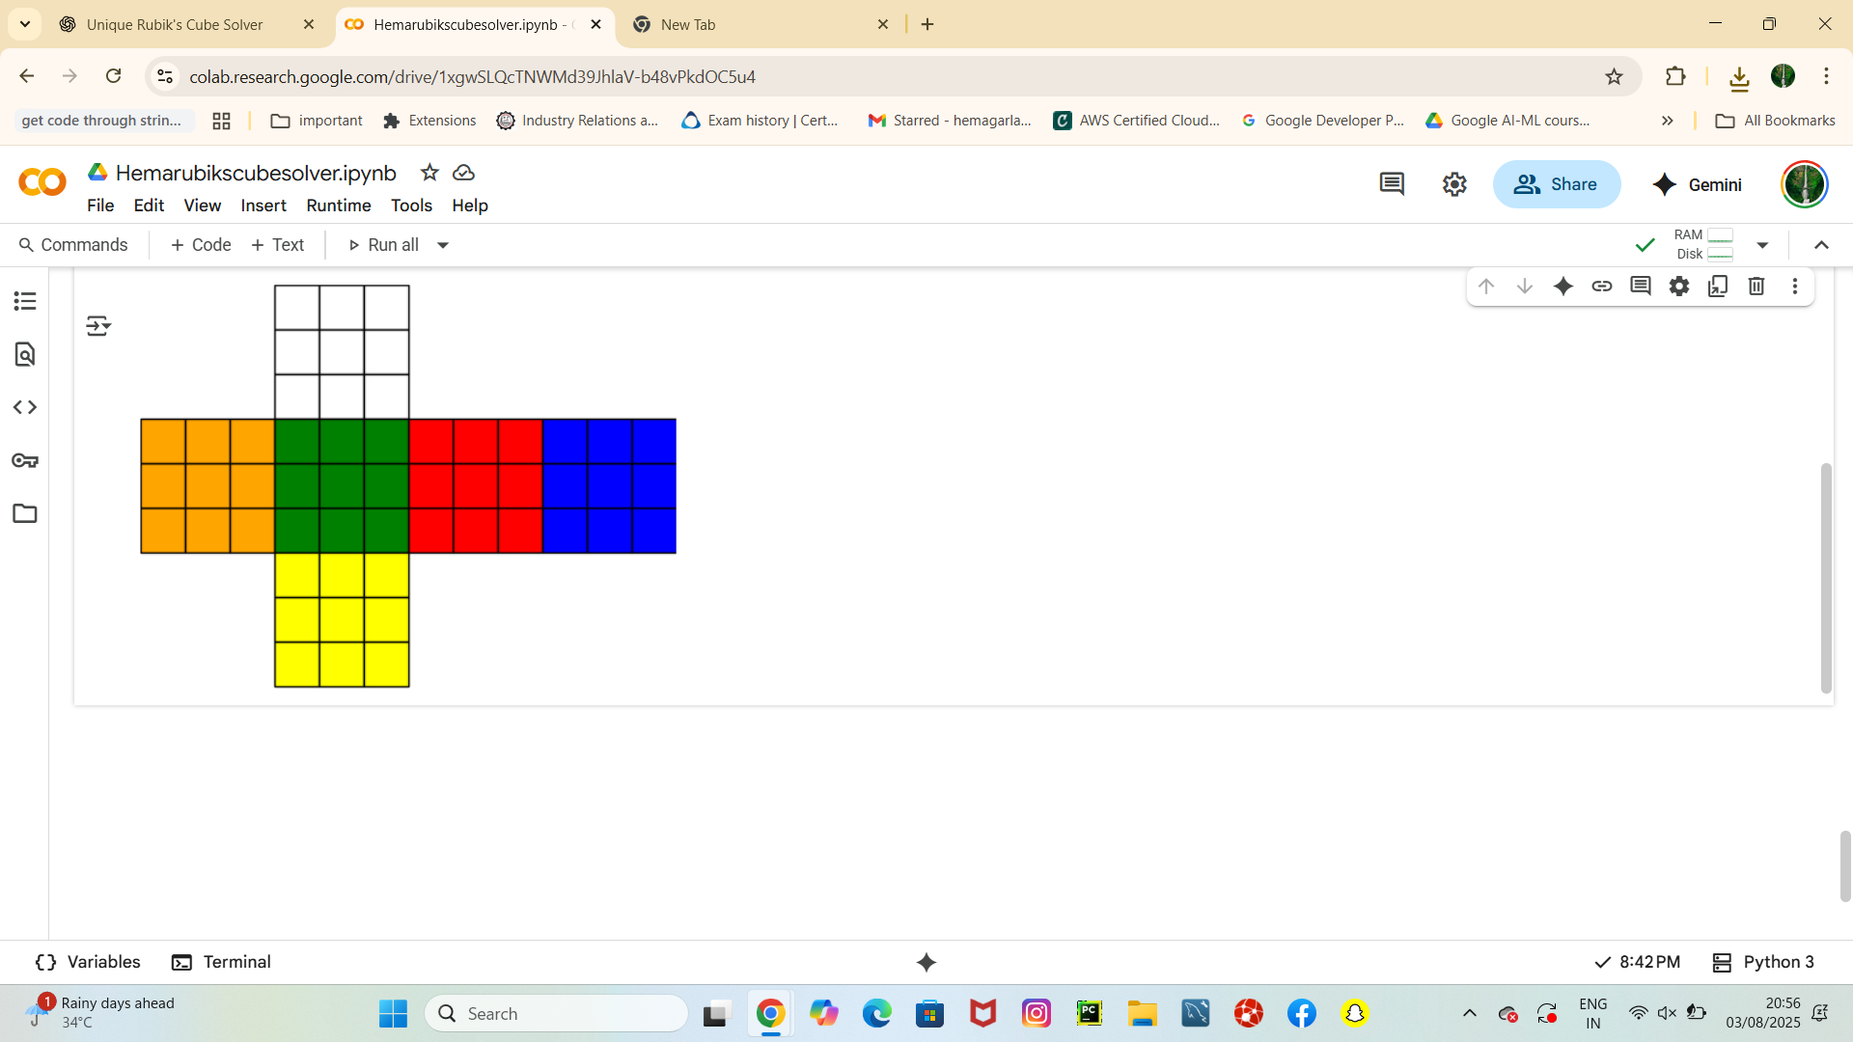
SAMPLE OUTPUT
Scrambled Cube:
Solved Cube:

Slide 7
FUTURE SCOPE
- Add 4x4 / 5x5 cube support - Add a Streamlit web UI - Integrate 3D visualization (e.g., Plotly) - Plug in Kociemba or optimal solvers

Slide 8
WHY ME?
-I love solving logical problems with code - Designed everything from scratch using Python - My submission shows clarity, optimization & creativity - I enjoy breaking down real-world challenges - “Solving problems with code gives me joy.”

Slide 9
THANK YOU
Name: Garlapati Hema Email: 2200031072cseh@gmail.com College: KL University ID: 2200031072

